Slide 1
Type conversion

Slide 3
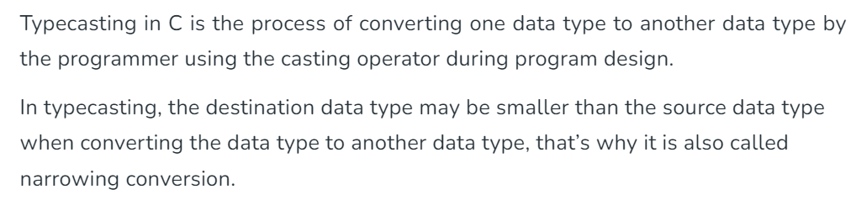
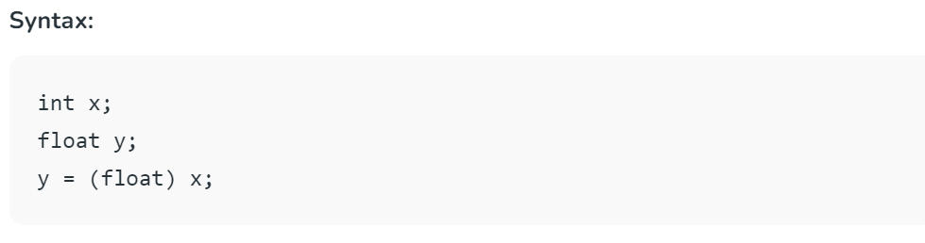

Slide 4
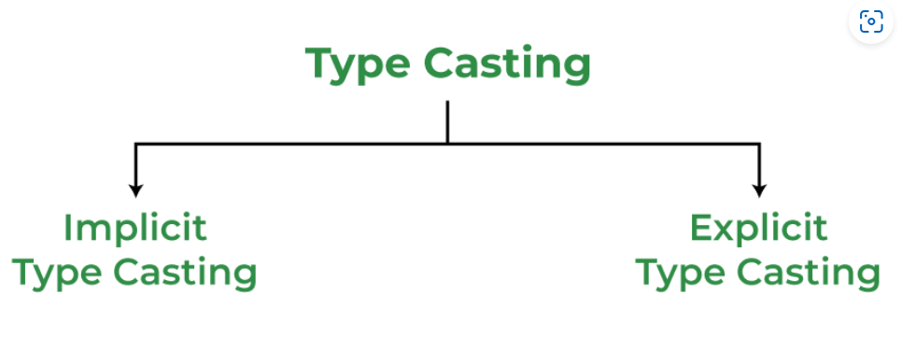

Slide 5
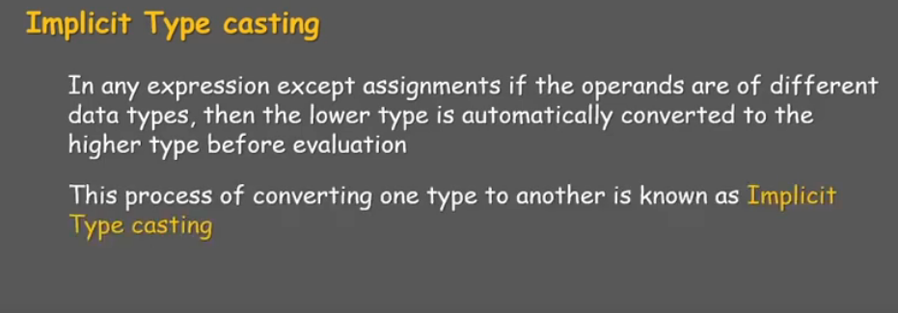
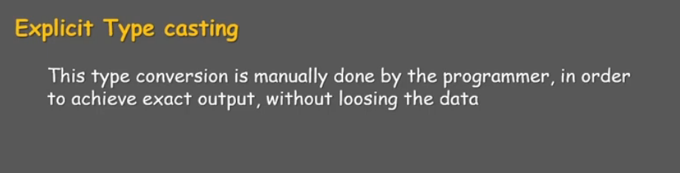

Slide 6
Type Conversions in Expressions
C permits mixing of constants and variables of different types in an expression
C automatically converts any intermediate values to the proper type so that the expression can be evaluated without losing any signification
This automatic conversion is known as Implicit Type Conversion

Slide 7
Implicit Type Conversions
Done by the compiler on its own, without any external trigger from the user.
Generally takes place when in an expression more than one data type is present
All the data types of the variables are upgraded to the data type of the variable with largest data type.
bool -> char -> short int -> int -> unsigned int -> long -> unsigned -> long long -> float -> double -> long double
It is possible for implicit conversions to lose information, signs can be lost (when signed is implicitly converted to unsigned), and overflow can occur (when long long is implicitly converted to float).

Slide 8
Implicit Type Conversions in Expressions
The following are the sequence of rules that are applied while evaluating expressions
Lower Type Operands | Higher Type Operands
Short or Char | int
One operand is Long double, the other will be converted to long double | Result is also long double
One operand is double, the other will be converted to double | Result is also double
One operand is float, the other will be converted to float | Result is also float
One operand is unsigned Long int, the other will be converted to unsigned long int | Result is also unsigned long int

Slide 9
Implicit Type Conversions in Expressions
Lower Type Operands | Higher Type Operands
One operand is Long int, and the other is unsigned int then a) If unsigned int can be converted to long int the unsigned int operand will be converted b) Else both operands will be converted to unsigned long int | Result will be long int Result will be unsigned long int
One operand is Long int, the other will be converted to long int | Result is also long int
One operand is unsigned Long int, the other will be converted to unsigned long int | Result is also unsigned long int

Slide 10
Implicit Type Conversions in Expressions
The final result of an expression is converted to the type of the variable on the left of the assignment sign before assigning the value to it
However the following changes are introduced during the final assignment
Float to int causes truncation of the fractional part
Double to float caused rounding of digits
Long int to int causes dropping of the excess higher order bits

Slide 11
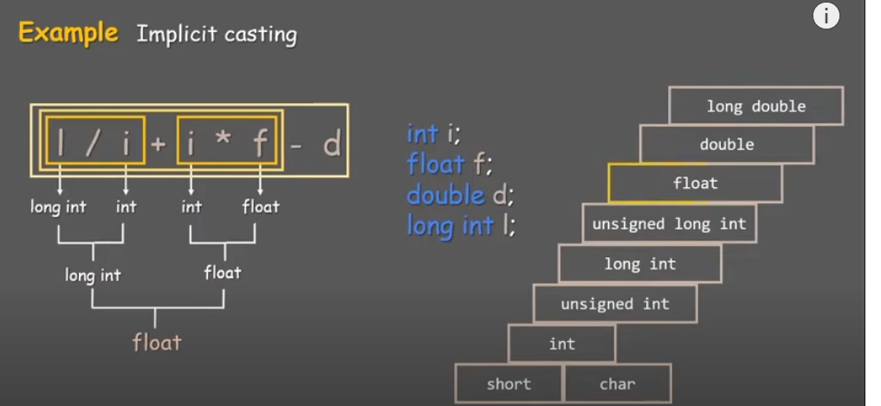

Slide 12
Implicit Type Conversion Example
int main()
{
int x = 10; // integer x
char y = 'a'; // character c
x = x + y;
float z = x + 1.0;
printf("x = %d, z = %f", x, z);
return 0;
}
Output:
x = 107, z = 108.000000

Slide 13
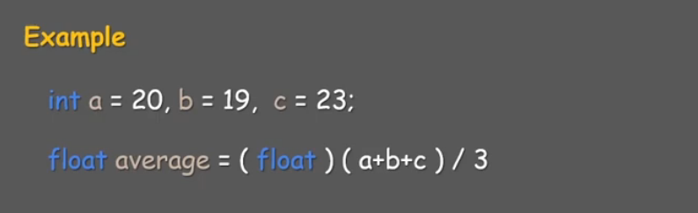

Slide 14
#include<stdio.h>
int main()
{
//Implcit method
int x=10;
char y='A';//A=65+10 =75
x=x+y;
printf("%d\n",x);
//explcit type casting
int a=15,b=2;
double c;
c=(double)a/b;
printf("%f\n",c);
int a1=10,a2=4;
float f=(float)a1/(float)a2;
printf("%f\n",f);
double d=10.5; //(type) varaible_name
int e;
e=(int)d;
printf("%d\n",e);
}

Slide 15
Explicit Type Conversions
There are instances when we want to force a type conversion in a way that is different from the automatic conversion
E.g ratio=57/67
Since 57 and 67 are integers in the program , the decimal part of the result of the division would be lost and ratio would represent a wrong figure
This problem can be solved by converting locally as one of the variables to the floating point as shown below:
ratio= (float) 57/67

Slide 16
Type Conversions in Expressions
The operator (float) converts the 57 to floating point then using the rule of automatic conversion
The division is performed in floating point mode, thus retaining the fractional part of result
The process of such a local conversion is known as explicit conversion or casting a value
The general form of a cast is
(type-name) expression

Slide 17
The Type Cast Operator
int a =150; float f; f = (float) a / 100; // type cast operator
The type cast operator has the effect of converting the value of the variable ‘a’ to type float for the purpose of evaluation of the expression.
This operator does NOT permanently affect the value of the variable ‘a’;
The type cast operator has a higher precedence than all the arithmetic operators except the unary minus and unary plus.
Examples of the use of type cast operator:
(int) 29.55 + (int) 21.99 results in 29 + 21
(float) 6 / (float) 4 results in 1.5
(float) 6 / 4 results in 1.5

Slide 18
Type Conversions in Expressions
Example | Action
x=(int) 7.5 | 7.5 is converted to integer by truncation
a=(int) 21.3/(int)4.5 | Evaluated as 21/4 and the result would be 5
b=(double)sum/n | Division is done in floating point mode
y=(int)(a+b) | The result of a+b is converted to integer
z=(int)a+b | a is converted to integer and then added to b
p=cos((double)x) | Converts x to double before using it

Slide 19
Integer and Floating-Point Conversions
Assign an integer value to a floating variable: does not cause any change in the value of the number; the value is simply converted by the system and stored in the floating format.
Assign a floating-point value to an integer variable: the decimal portion of the number gets truncated.
Integer arithmetic (division):
int divided to int => result is integer division
int divided to float or float divided to int => result is real division (floating-point)

Slide 20
Integer and Floating-Point Conversions
#include <stdio.h>
int main ()
{ float f1 = 123.125, f2;
int i1, i2 = -150;
i1 = f1; // float to integer conversion
printf(“float assigned to int produces”);
printf(“%d\n”,i1);
f2 = i2; // integer to float conversion
printf(“integer assigned to float produces”);
printf(“%f\n”,f2);
i1 = i2 / 100; // integer divided by integer
printf(“integer divided by 100 produces”);
printf(“%d\n”,i1);
f1 = i2 / 100.0; // integer divided by a float
printf(“integer divided by 100.0 produces”);
printf(“%f\n”,f1);
return 0;
}
123
-150.0
-1
-1.5

